Slide 1
ANLAYSIS OF STUDENT'S STUDY HABITS AND MENTAL WELL-BEING ON ACADEMIC PERFORMANCE
PRESENTED BY
BHUVANESWAR D

Slide 2
PROJECT OBJECTIVE
Understand the Impact of Lifestyle Habits on Academic Success.
Identify Mental Health Trends Among Students.
Empower Data-Driven Interventions for Student Wellness.

Slide 3

Problem statement
Background: In today's fast-paced educational environments, students navigate multiple habits that may affect their academic performance. However, these habits often go unmonitored and uncorrelated.
Scope: The study is focused on students habits and evaluates key lifestyle against the academic results.
Stakeholders
Academic Instructors
Psychologist

Slide 4
DATA SOURCES
Include features such as:
Student ID
Exam score
Age
Gender
Study hours per day
Social media hours
Netflix hours
Part time job
Attendance percentage
Sleep hours
Diet quality
Exercise frequency
Parental education level
Internet quality
Mental health rating
Extracurricular participation
PRIMARY DATA SOURCE:
Primary data source taken from Kaggle.
Dataset: https://www.kaggle.com/datasets/jayaantanaath/student-habits-vs-academic-performance
Creator: Jayanta Nath.

Slide 5
DATA model & PREPROCESSING
Structured as a single fact table with necessary features.
No complex relationships — direct analysis from a clean dataset.
Replaced null values with the category “Uneducated” to ensure consistency during analysis.
Created new column:
Exercise(Daily, Frequently, Moderately, Never)
Mental Health Condition(Excellent, Good, Moderate, Poor)

Slide 6
VISUALIZATIONS
Stacked area chart:
Exam score by Attendance percentage and Netflix hours.
Stacked column chart:
Exam scores by Sleep hours.
Exam scores by Social media hours.
Pie chart:
Line chart:
(AVG) Exam scores by Study hours per day.
Exam scores by Mental Health condition and Rating.
Button Slicer:
Card:
Age, Gender
Average Exam Scores
Tree Map:

Slide 7
INSIGHTS
Students who attend class regularly performed better than others.
Students with good mental health can focus, learn, and perform better and even got excellent grades.
Sleep is your secret weapon.
Students who have balanced their screen time with study hours achieved good grades.
A noticeable decline in exam scores is seen as exercise frequency decreases.

Slide 8
The average exam scores remain relatively stable across age groups 17 to 24, with only slight fluctuations.
Students with part-time jobs show nearly the same average exam scores as those without.
Students engaged in extracurricular activities have marginally better exam scores than those who aren’t.
Slightly higher average scores are observed in students with “Fair” diet quality, followed closely by “Good” and “Poor.”
The data highlights that moderately educated parents (Bachelor) correlate with better average student performance, more than the Master’s level.

Slide 9
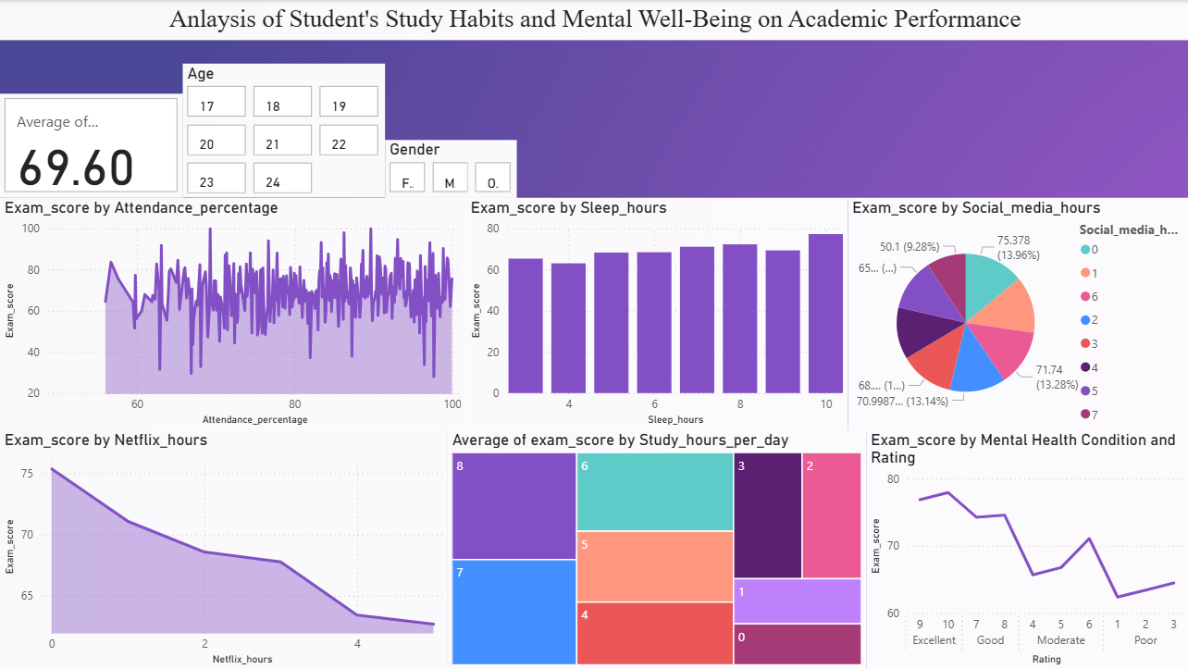

Slide 10
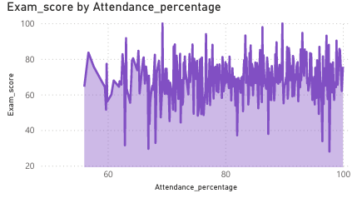
Attendance: the foundation
Clear correlation between attendance and performance.
Students with higher attendance percentage consistently achieve better exam scores.
Recommendation: Even small improvements in attendance rates can yield significant academic gains.

Slide 11
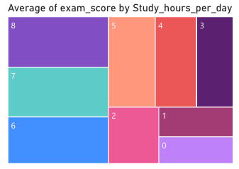
Study Hours: Quality Over Quantity Matters
Students dedicating 6-8 hours of daily study time show optimal performance.
Reduced efficiency observed below 8 hours, suggesting the importance of balanced study schedules.

Slide 12
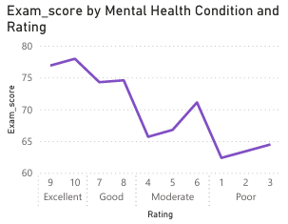
Mental health & well-being Impact
Students with "Excellent" and "Good" mental health ratings significantly outperform their peers
Mental well-being directly correlates with academic achievement
Investment opportunity: Mental health support programs could drive measurable academic improvements

Slide 13
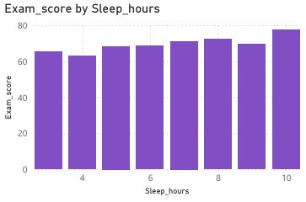
Sleep: the performance enhancer
Optimal sleep duration (7-8 hours) correlates with peak academic performance.
Students with inadequate sleep show notable performance decline.

Slide 14
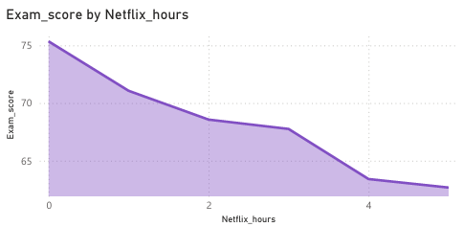
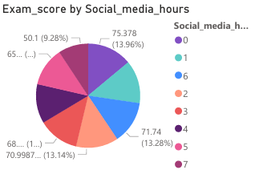
Digital challenges
Light usage of Netflix and social media shows minimal impact on performance.
Heavy streaming and excessive usage shows performance degradation.

Slide 15
Conclusion
Attendance and Mental Health plays a prominent role in securing an excellent academic grades.
Academic performances is influenced by multiple factors such as attendance, mental stability, digital network usage and study hours.
This analysis helps the stakeholders to understand performance, trends, risks and opportunities.

Slide 16
Thank you

